Slide 1
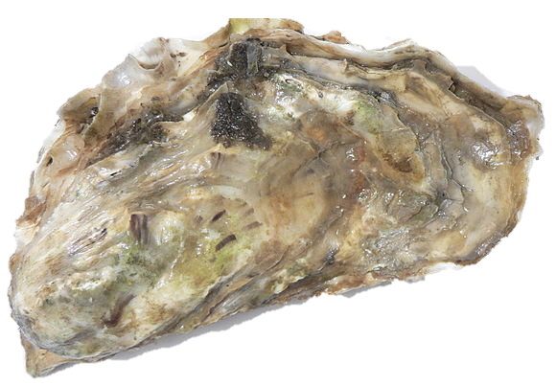

The genetic legacy of the deliberate introduction of Pacific oysters
Erik Sotka
Allan Strand
Ryan Carnegie, Jim Carlton, Lucia Couceiro, Jeff Crooks, Hikaru Endo, Hilary Heyford, Masakazu Hori, Mits Kamiya, Gen Kanaya, Judith Kochmann, Kun-Seop Lee, Lauren Lees, Hannah Miller, Massa Nakaoka, Eric Pante, Jennifer Ruesink, Evangelina Schwindt, Åsa Strand, Richard Taylor, Ryuta Terada, Martin Thiel, Takefumi Yorisue, Danielle Zacherl

Slide 2
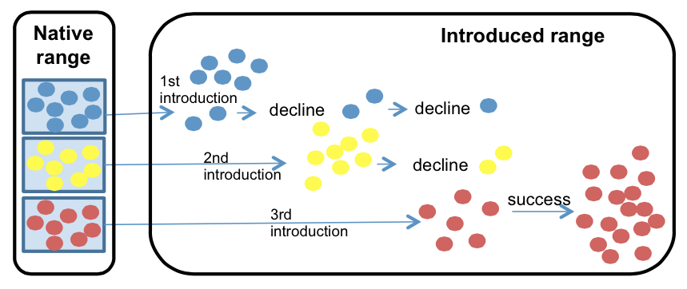
Importance of identifying vectors and the native sources of introduced species
Prevent future invasions
Understand how it succeeds
Understand its future threat (adaptive capacity)
Rius et al. 2014 Biol. Inv.

Slide 3
The greatest agency of all that spreads marine animals to new quarters of the world must be the business of oyster culture, a very ancient and world-wide craft. – Charles Elton (1958)

Slide 4
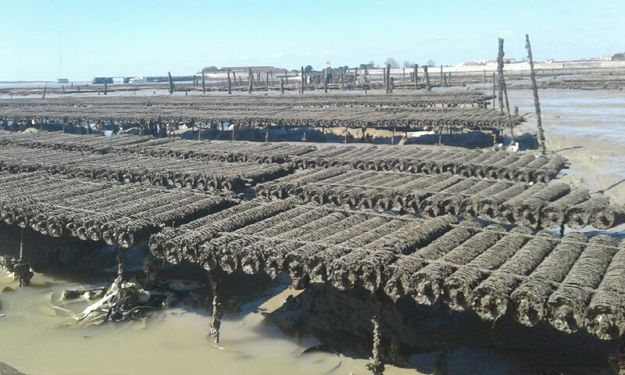
Crassostrea (Magallana) gigas Pacific cupped oyster
Among the most important aquacultural shellfish worldwide
C. gigas aquaculture
- $1.2 Billion per year
- 644,000 tons per year
Eric Pante

Slide 5
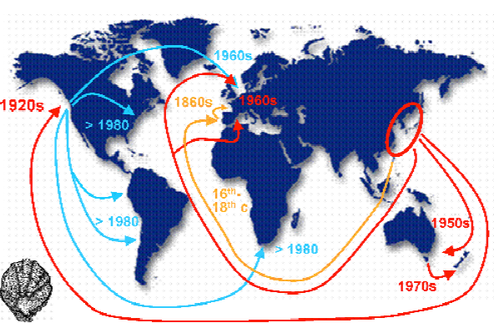
Crassostrea (Magallana) gigas Pacific cupped oyster
Among the most important aquacultural shellfish worldwide
Deliberately introduced to five continents for at least 150 years
Troost 2010

Slide 6
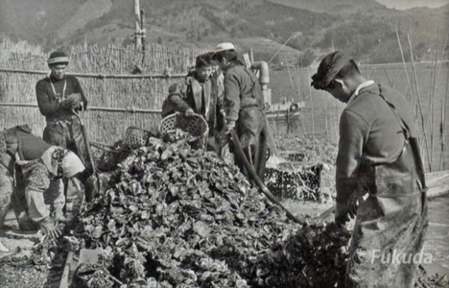
Crassostrea (Magallana) gigas Pacific cupped oyster
Among the most important aquacultural shellfish worldwide
Deliberately introduced to five continents for at least 150 years
An important vector for nonnative marine and estuarine species*
Professor Yasuyuki Koike
Oyster World Congress 2012
*Naylor et al., 2001, Ruiz et al. 2015, Ruesink et al. 2000

Slide 7
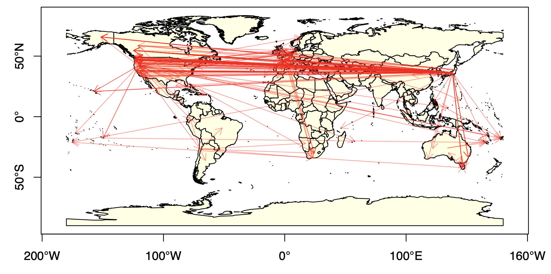
Historical record of introductions is extensive but not confirmed
405 Pacific Oyster shipments
- Compiled by Laney Pound (CofC)

Slide 8
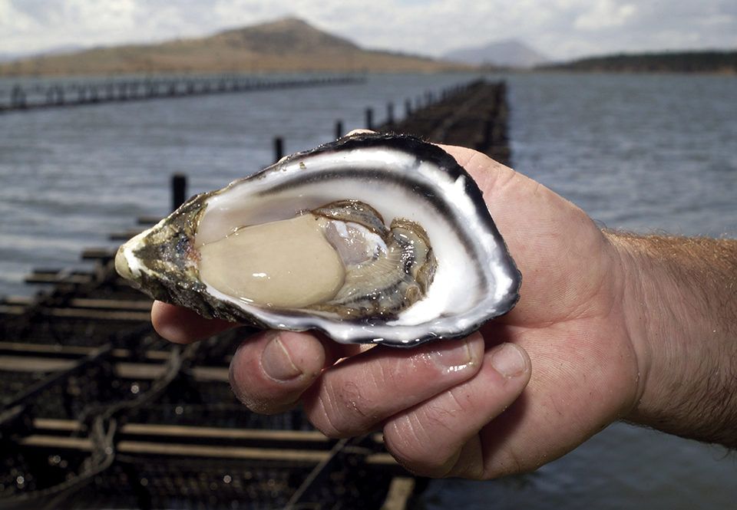
Genetic legacy of Pacific oyster introductions
Population genetic structure of native populations
The invasion history of non-native populations
Role of oyster invasions on species introductions
Bruce Miller, CSIRO

Slide 9
Genetic legacy of Pacific oyster introductions
Population genetic structure of native populations
The invasion history of non-native populations
Role of oyster invasions on species introductions
Bruce Miller, CSIRO

Slide 10
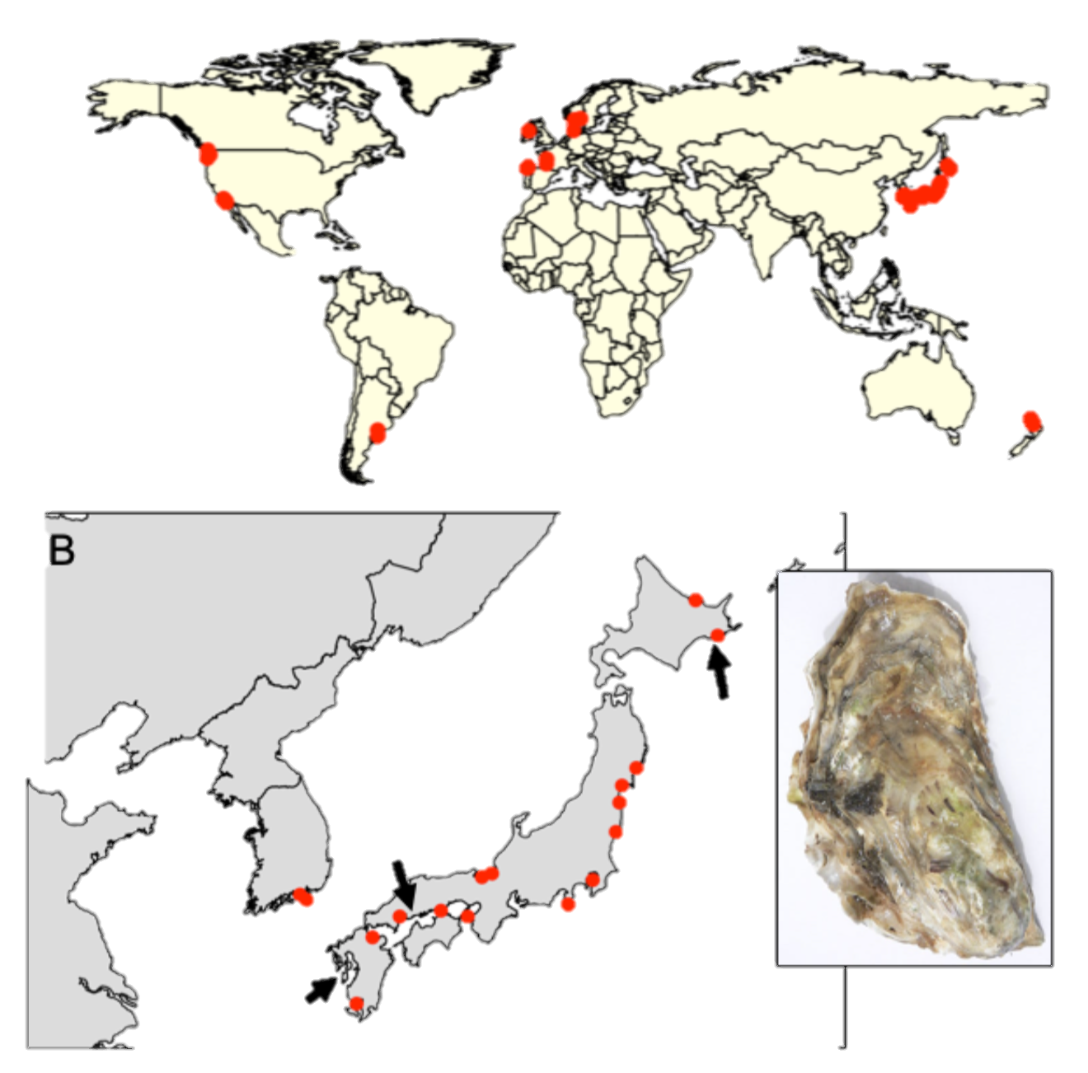
Sampling design
41 populations (n ~ 20)
20 native (Korea, Japan)
21 non-native (Europe, Western US, Chile, Argentina, NZ)
Feral populations (on rocks, jetties, reefs, etc..)
Genotype-by-sequencing
Dataset: 726 individuals from 7046 loci (no missing data and at HWE)
Hokkaido
Miyagi
Hiroshima
Kumamoto
Notes:
Kumamoto C. sikamea oyster

Slide 11
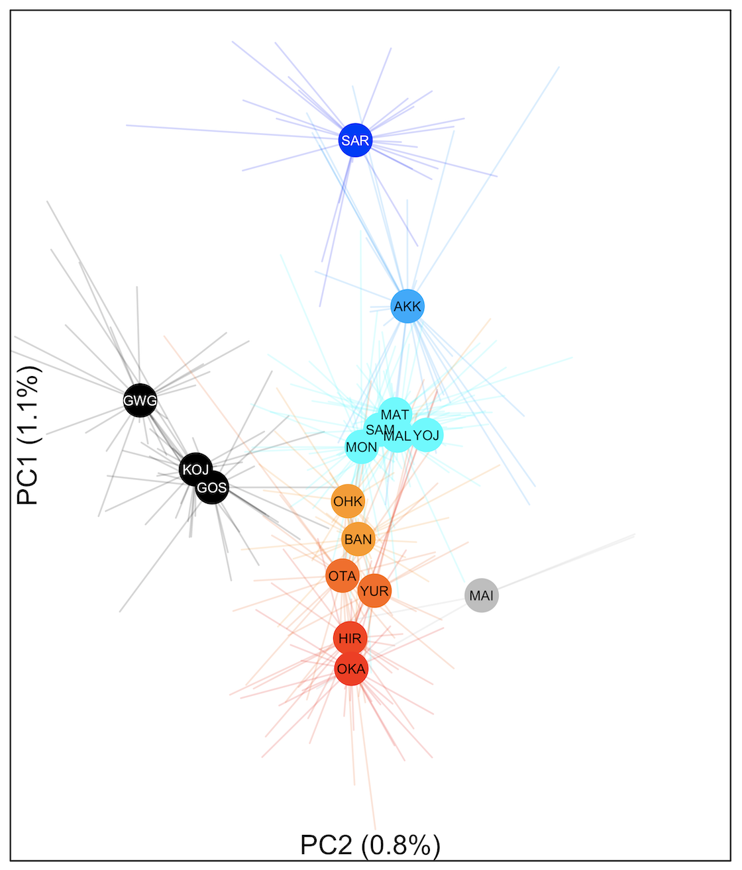
Genetic differentiation along latitude in Japan Φ_{ST} = 0 to 0.011
colors based on Genetic PC1
Hokkaido
Miyagi
Hiroshima
**

Slide 12
Hokkaido
Miyagi
Hiroshima

Slide 13
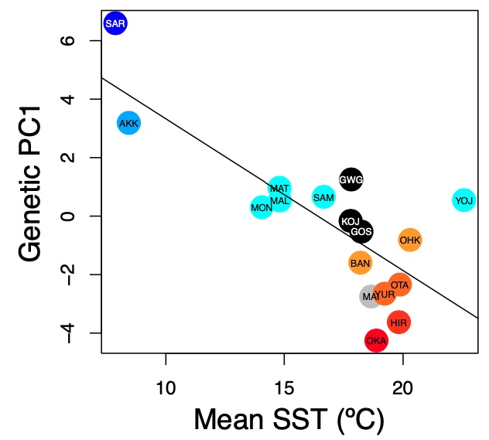
Genetic PC1 correlates with sea surface temperature (SST)
Native: r = -0.777; p< 0.001

Slide 14
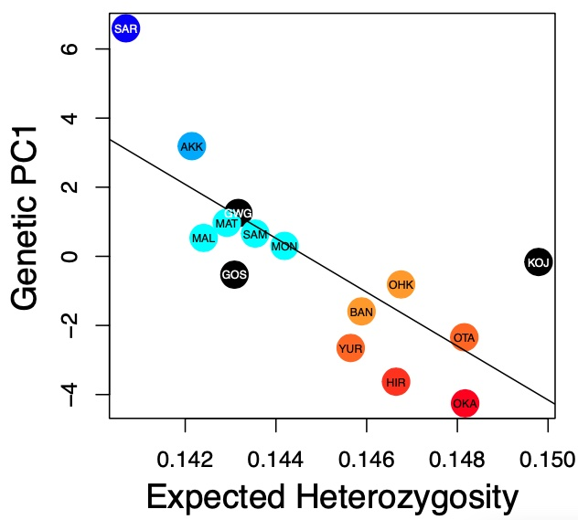
Genetic PC1 correlates with sea surface temperature (SST) and heterozygosity
Native: r = -0.777; p< 0.001
Native: r = -0.755; p = 0.001

Slide 15
Genetic legacy of Pacific oyster introductions
Population genetic structure of native populations
The invasion history of non-native populations
Role of oyster invasions on species introductions
Bruce Miller, CSIRO

Slide 16
Can we assign non-native populations assigned to native sources?
colors based on Genetic PC1

Slide 17
Seto Inland Sea ➔ New Zealand
colors based on Genetic PC1

Slide 18
Miyagi ➔ European, Canadian and WA populations
colors based on Genetic PC1

Slide 19
Southern California are intermediate between Seto Inland Sea and Miyagi (as is Tokyo)
colors based on Genetic PC1

Slide 20
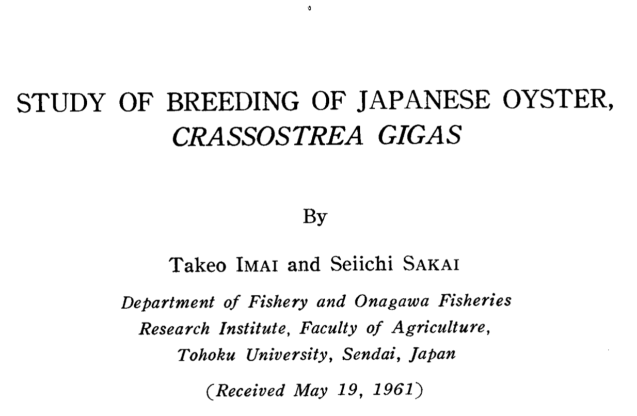
Oyster biologists identified “appropriate” genetic sources via transplant experiments
Imai and Sakai 1961

Slide 21
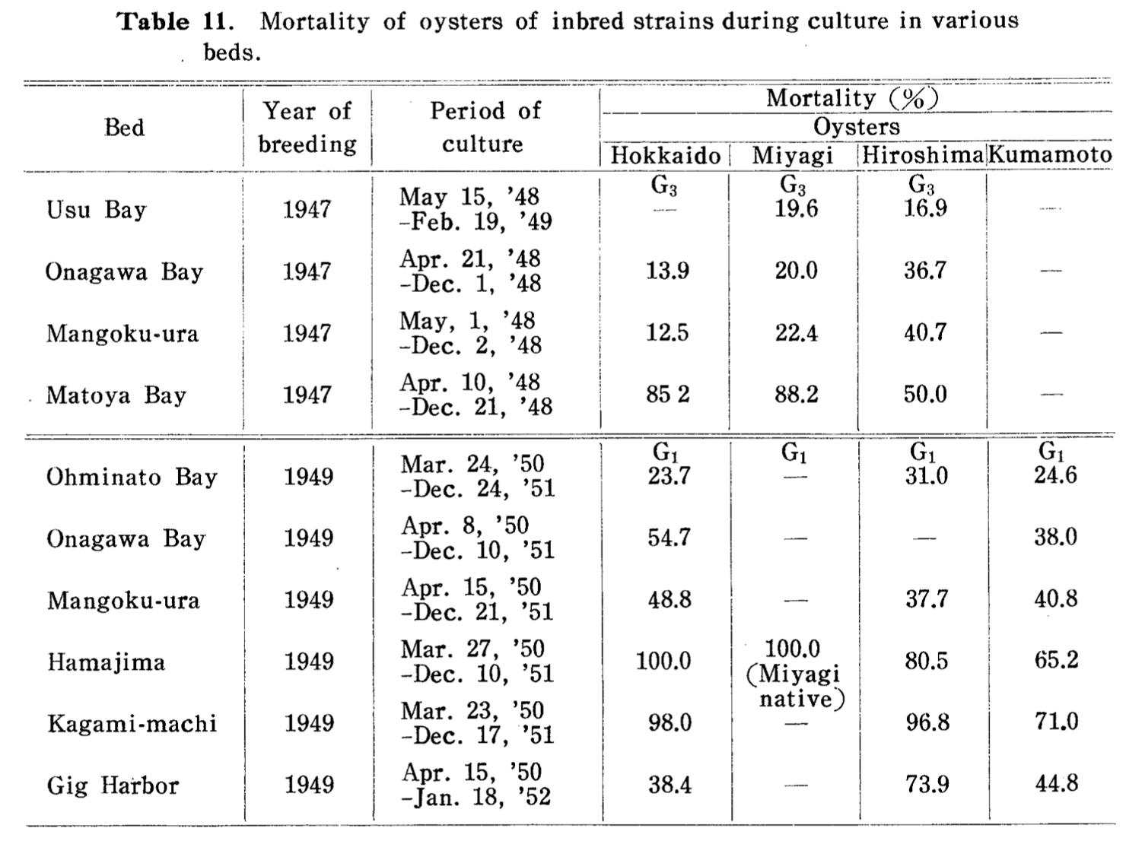
Oyster biologists identified “appropriate” genetic sources via transplant experiments
Imai and Sakai 1961
Puget Sound WA
(47ºN)
Southern Japan
(33ºN)
Northern Japan
(44ºN)

Slide 22
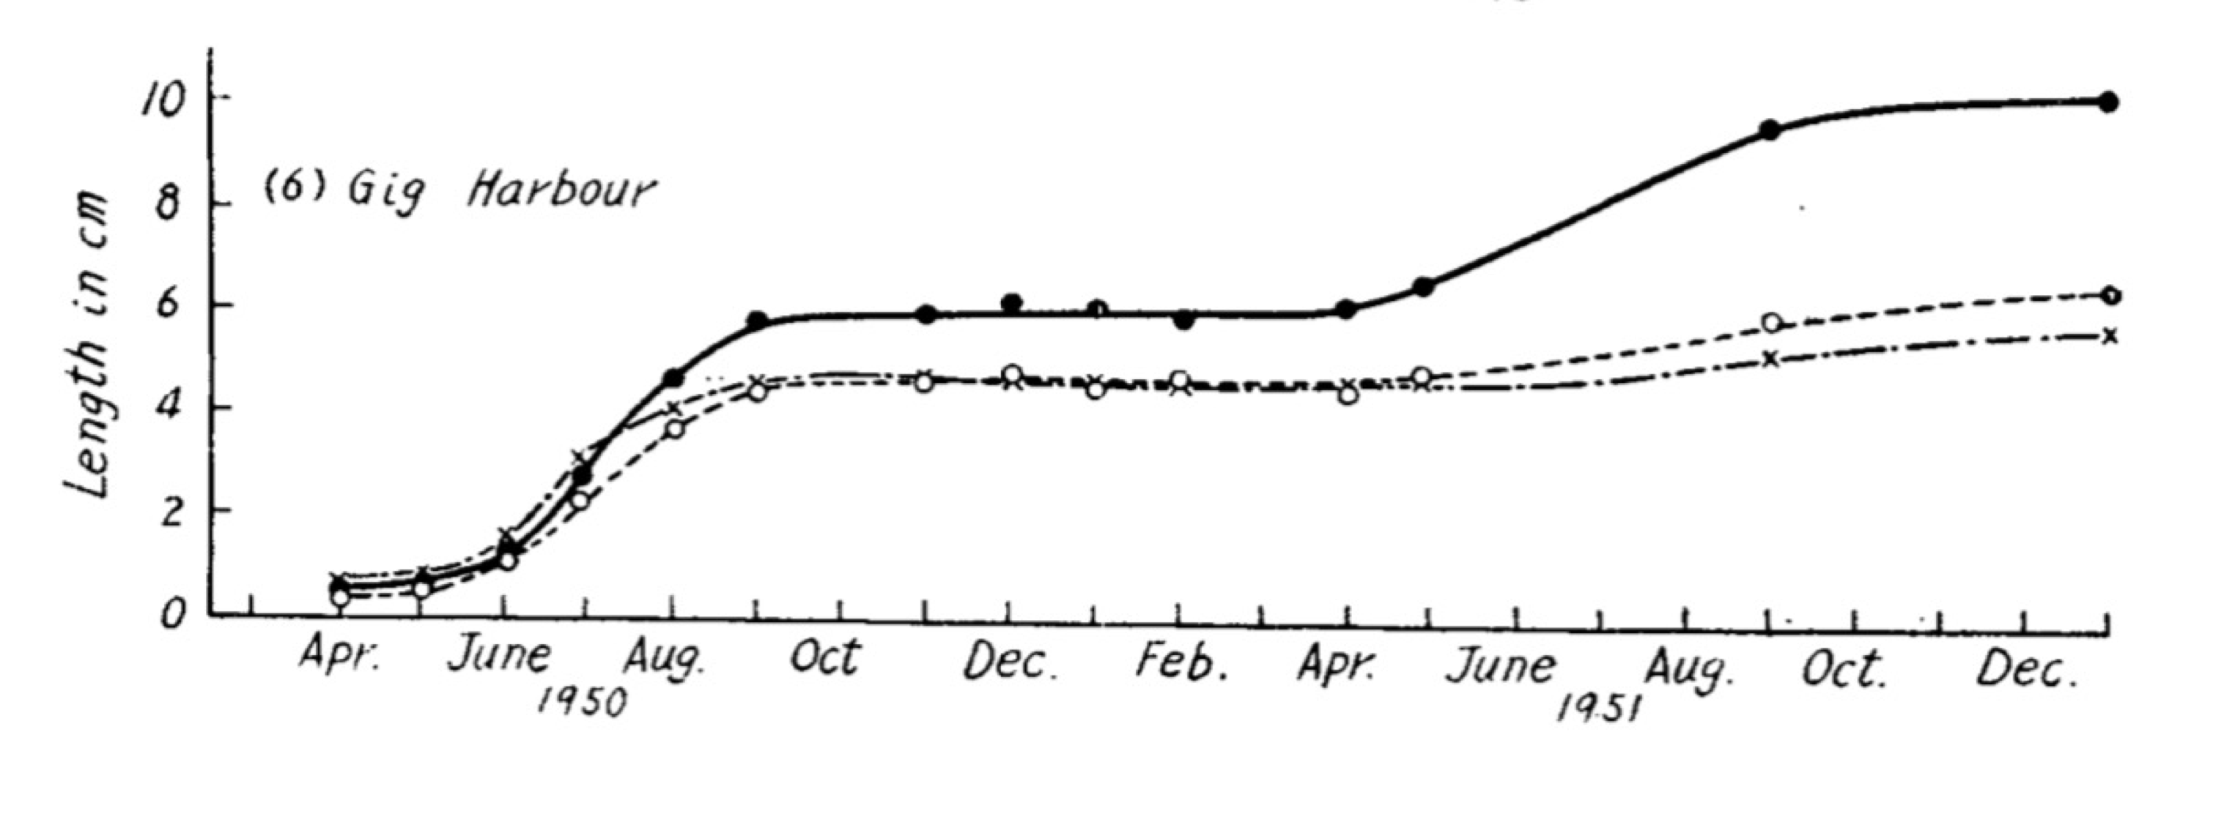
Oyster biologists identified “appropriate” genetic sources via transplant experiments
Imai and Sakai 1961
Hokkaido
Hiroshima
Kumamoto

Slide 23
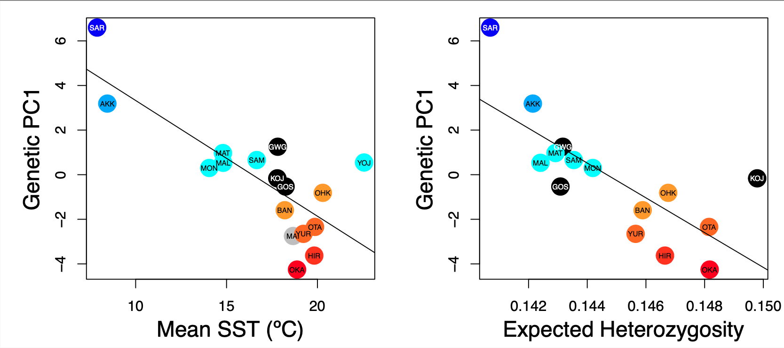
“Deliberate ecological fitting” of Pacific oysters
Native: r = -0.78; p< 0.001

Slide 24
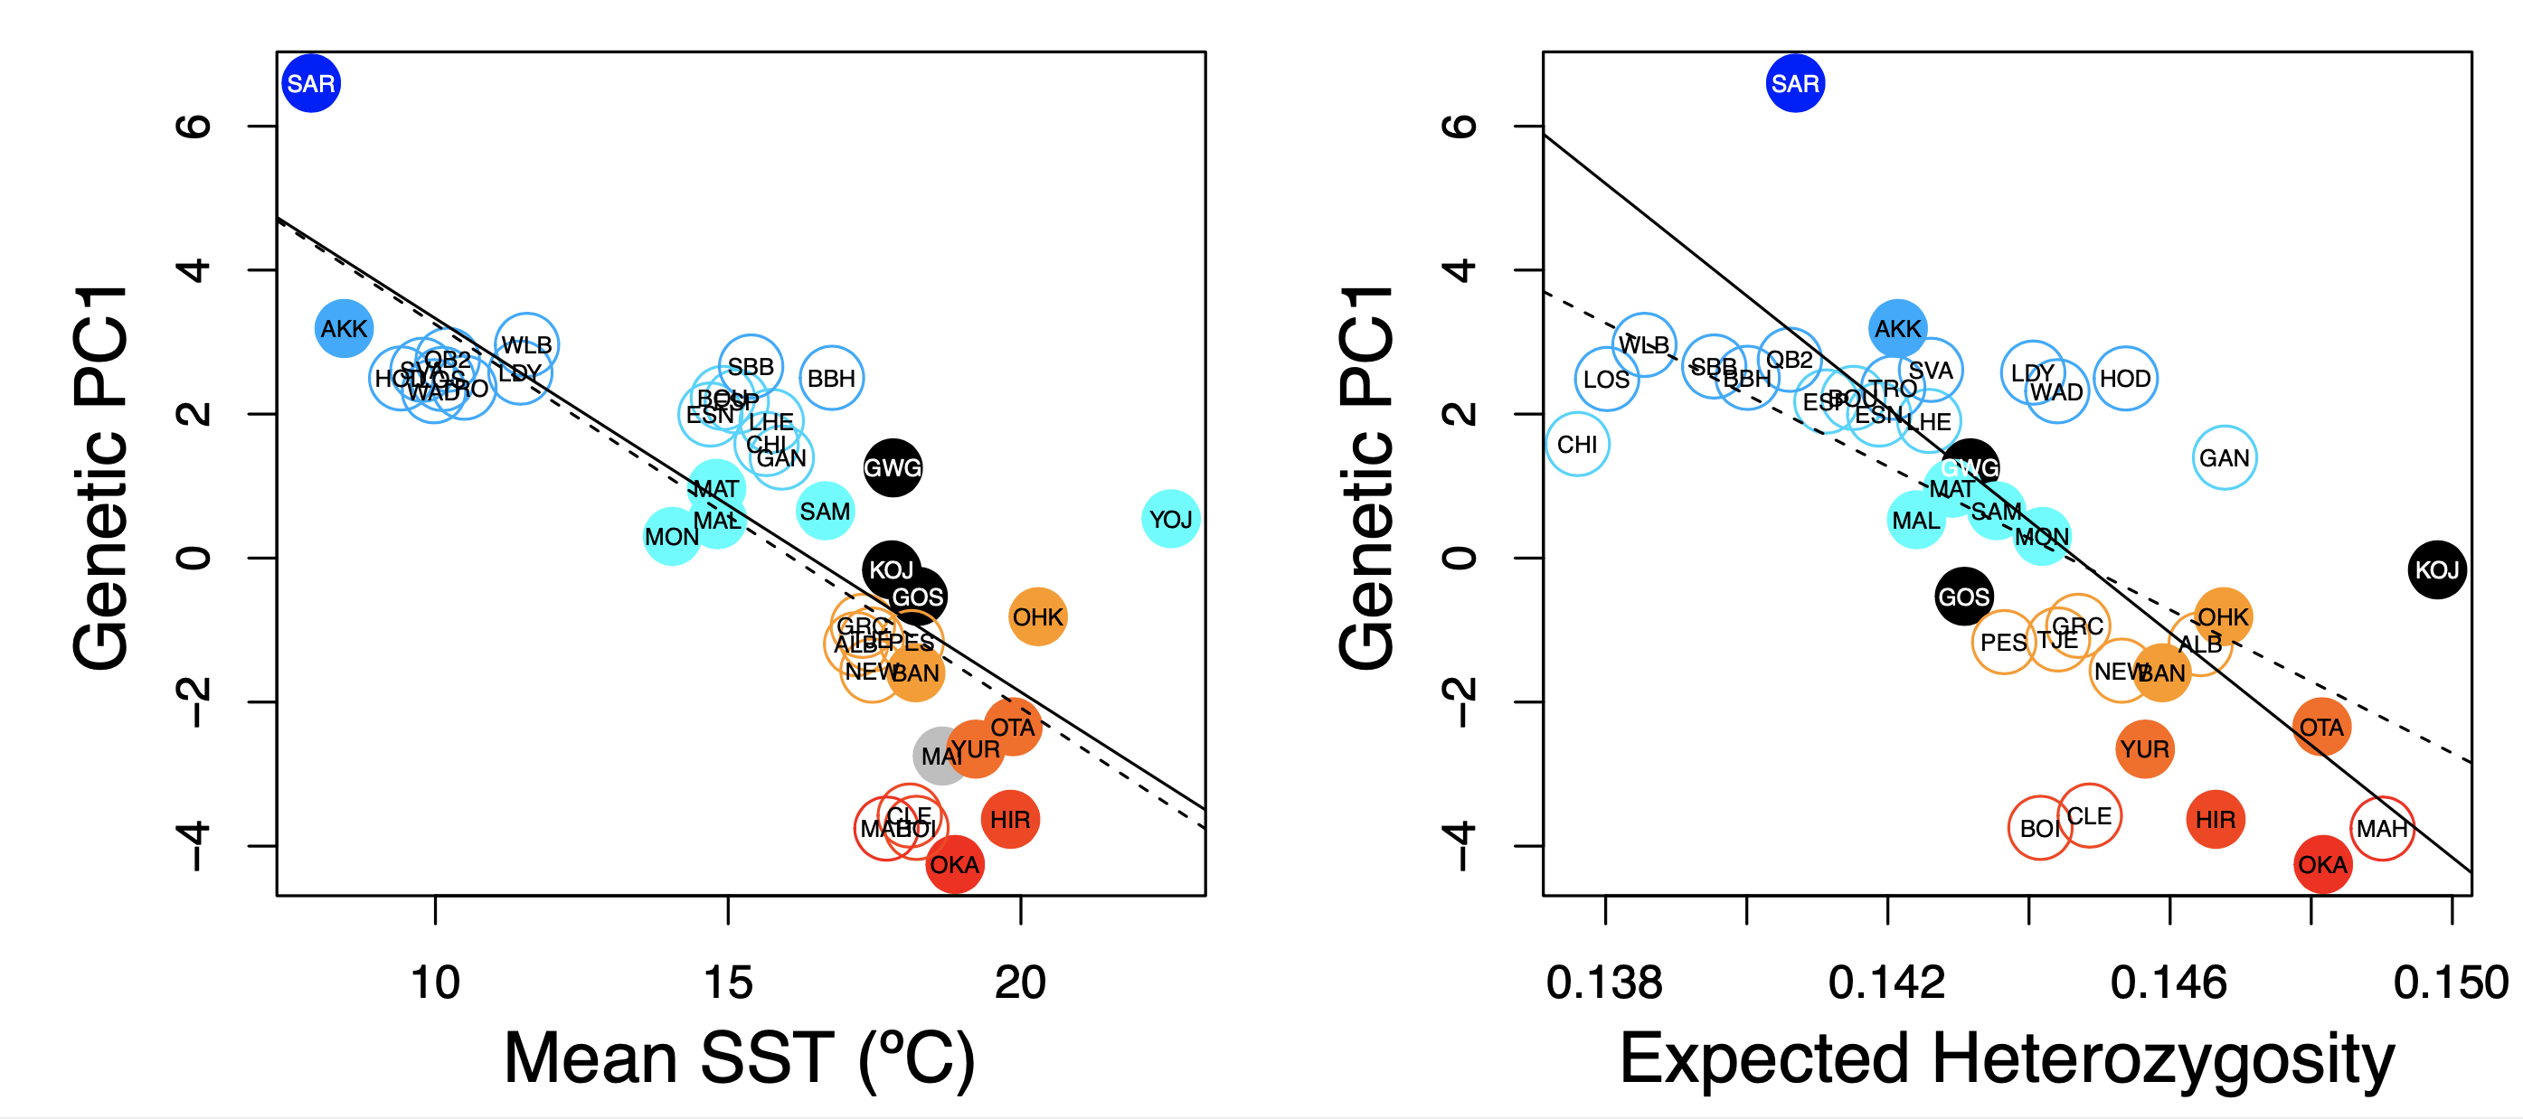
“Deliberate ecological fitting” of Pacific oysters
Native: r = -0.78; p< 0.001
Introduced: r = -0.74; p < 0.001
Ecological fitting reflects deliberate decisions by smart oyster biologists of appropriate genetic sources

Slide 25
A genetic legacy of Pacific oyster introductions
Native: r = -0.76; p = 0.001

Slide 26
A genetic legacy of Pacific oyster introductions
Native: r = -0.76; p = 0.001
Introduced: r = -0.63; p < 0.001
Introduced populations maintain similar heterozygosity as their genetic source

Slide 27
Genetic legacy of Pacific oyster introductions
Population genetic structure of native populations
The invasion history of non-native populations
Role of oyster invasions on species introductions
Bruce Miller, CSIRO

Slide 28
Bonnot (1935) documented the occurrence of invasive mollusks with imported Japanese oyster shipments to North American estuaries.
From ad hoc reviewers of K-H 2017 at Mol Ecol
Furthermore, their claims to identify the vector (C. gigas) remains purely speculative - this would be confirmed by congruent patterns of genetic diversity of both C. gigas and G. vermiculophylla in their native and introduced ranges.
"... our results support anecdotal evidence that oysters were the key vector for the G. vermiculophylla invasion." Congruent patterns of genetic diversity across the two species would have clarified this - as it is, there is only "arm-waving".
All in all, there is not conclusive evidence in the manuscript to convince the reader about the role of C. gigas as a vector beside the coincidental presence in the northern hemisphere. A comparison between the genetic structure of the vector and of the alga could have been attempted.
“Because this area historically served as the principal source for oyster exports worldwide, we suggest that oysters were the key vector for the G. vermiculophylla invasion. “ Krueger-Hadfield et al 2017 Ecology and Evolution
“The source region historically provided seed oysters (Crassostrea gigas) for aquaculture in North America” Miura et al. 2001 PNAS

Slide 29
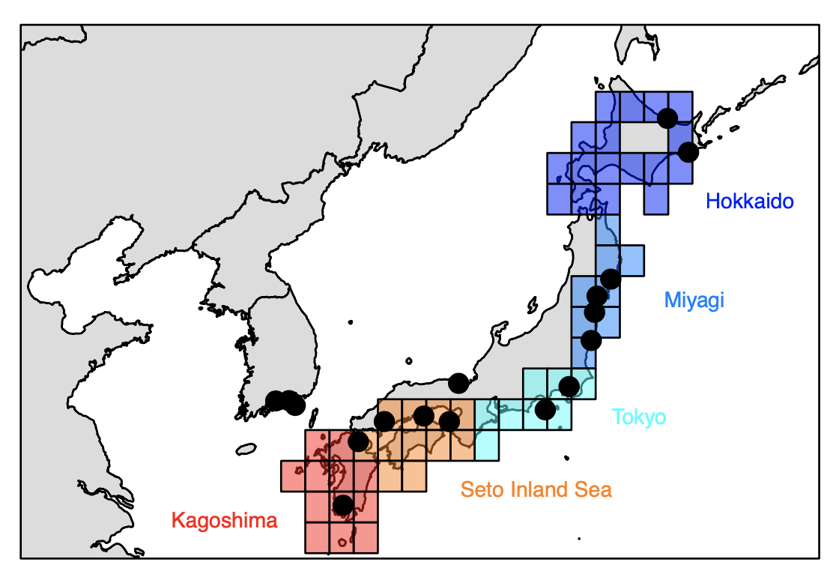
Add circlize plots

Slide 30
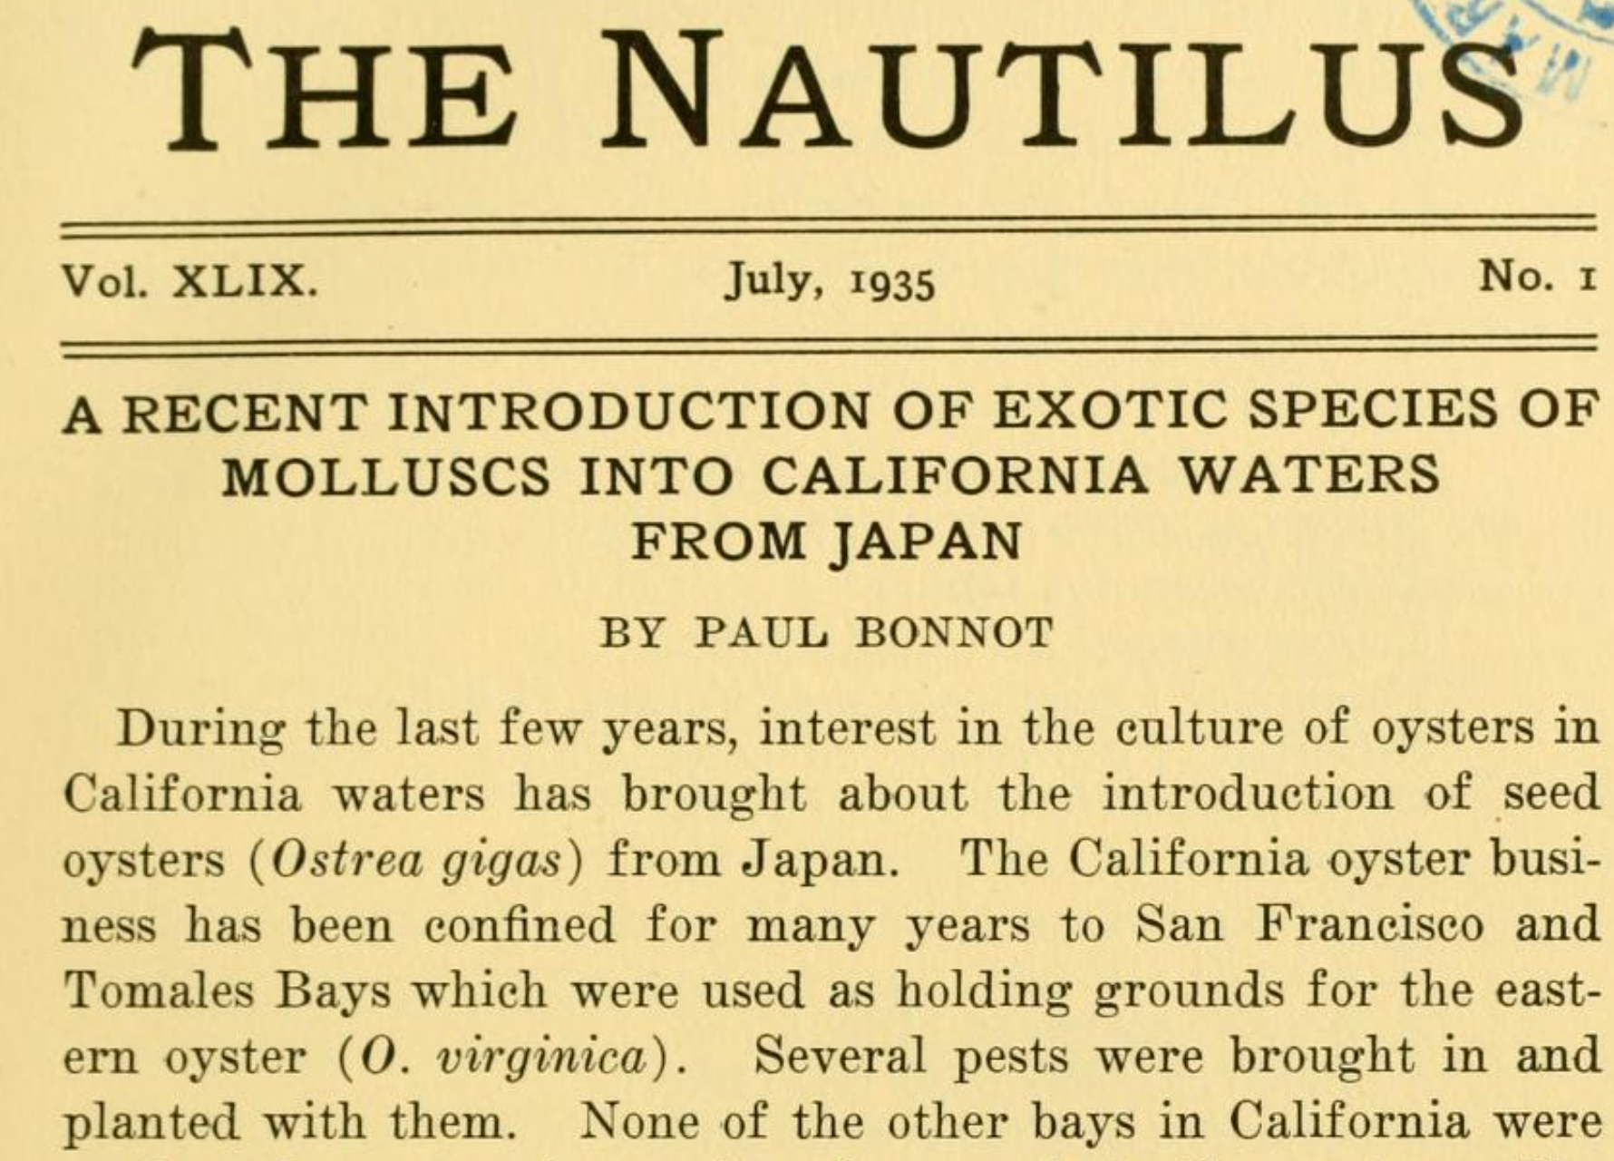

Slide 31
The greatest agency of all that spreads marine animals to new quarters of the world must be the business of oyster culture, a very ancient and world-wide craft. – Charles Elton (1958)

Slide 32
Pacific oysters from Europe and Canada, Washington state came from northern Japan
Circlize plots; Machine learning

Slide 33
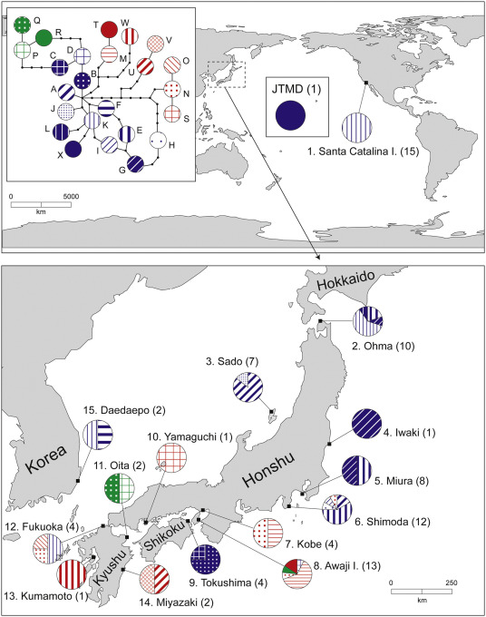

Slide 34
Pacific oysters from southern California are a mix of northern and southern Japan
Pacific oysters from New Zealand came from southern Japan
Circlize plots; Machine learning

Slide 35
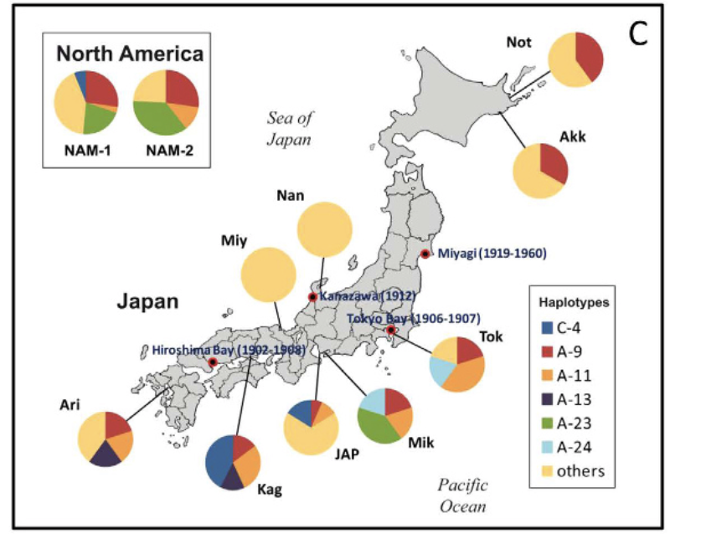
Notes:
Ruditapes

Slide 36
Battillaria attramentaria
Miura et al. 2005 PNAS

Slide 37
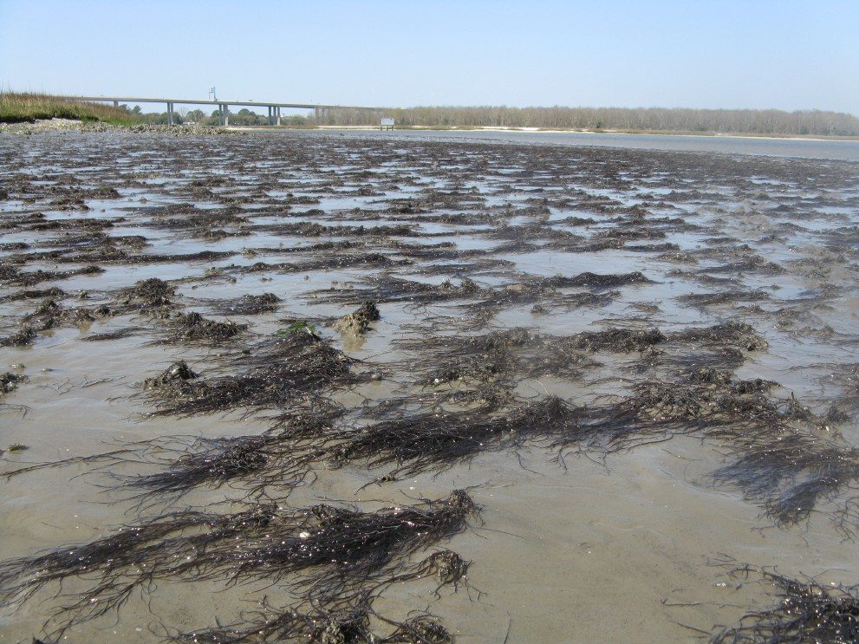
Gracilaria vermiculophylla

Slide 38
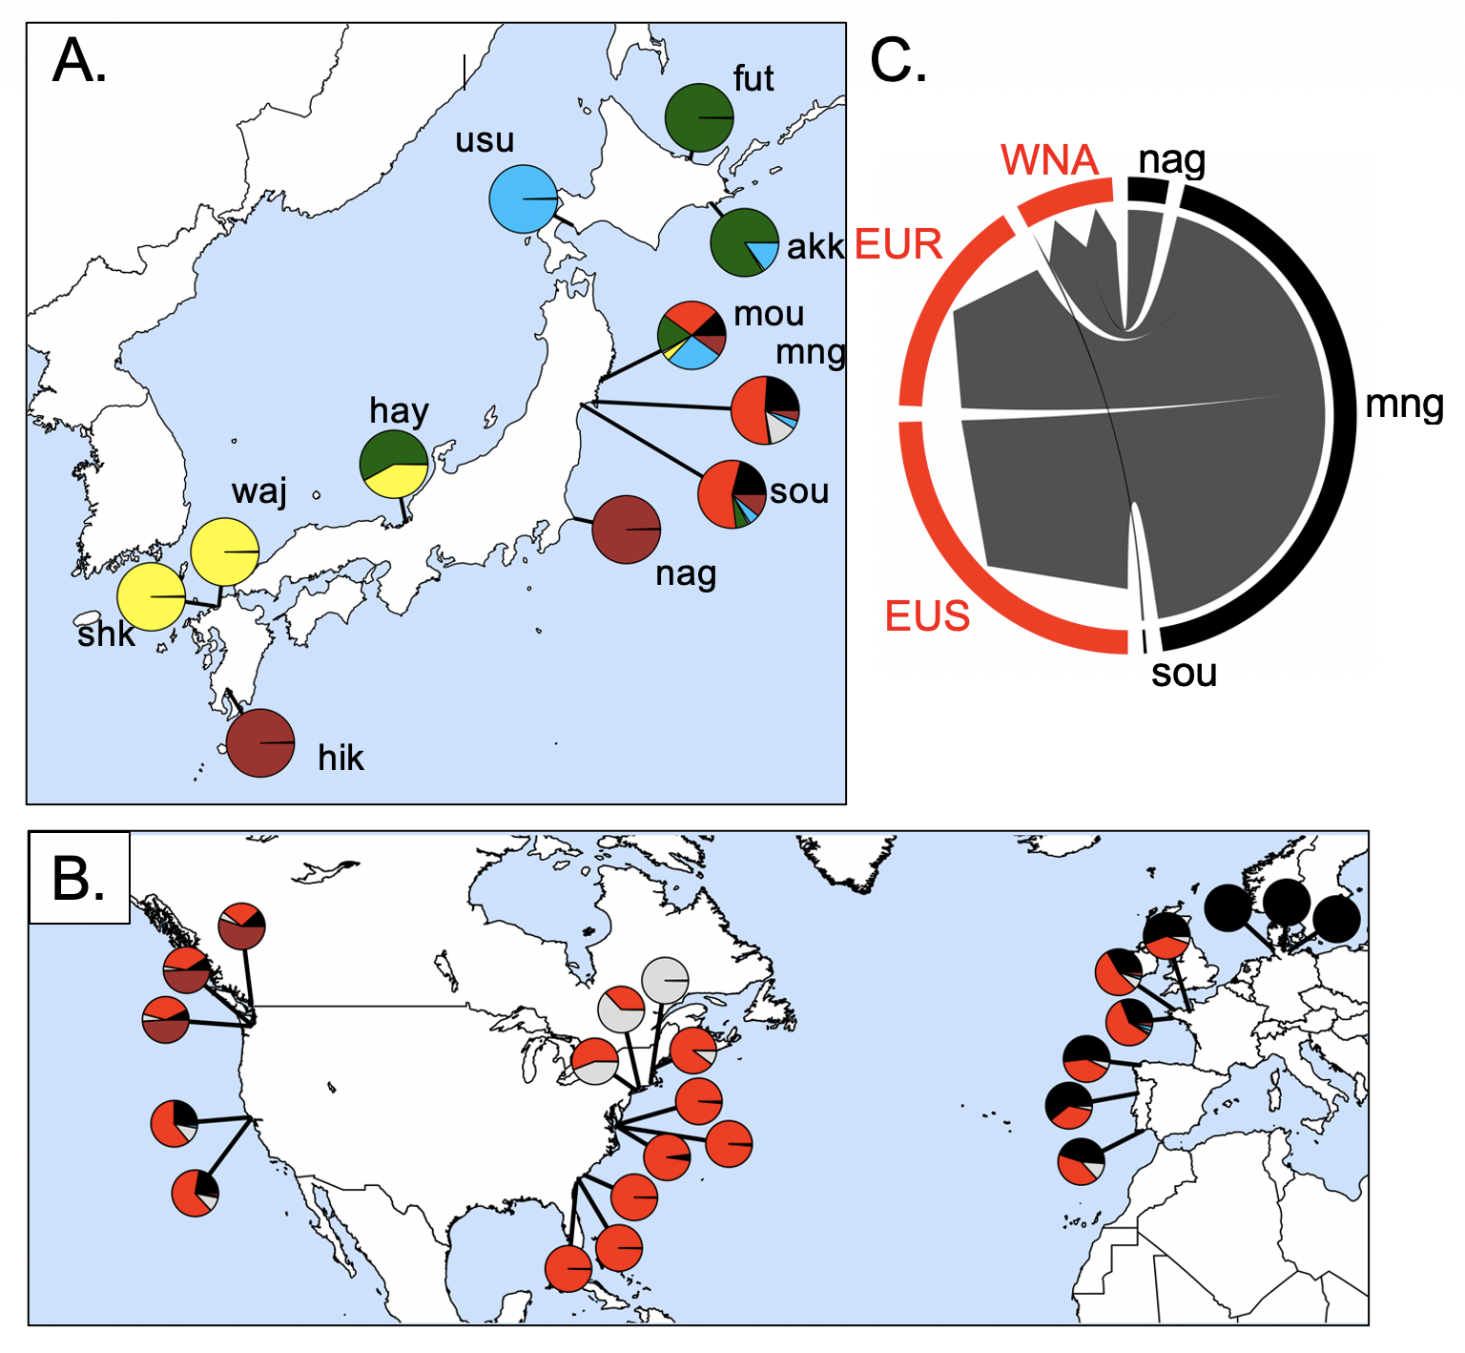
Source of the invasion is northeastern Japan
62,235 SNPs
32 populations
Admixture analysis
Flanagan, Krueger-Hadfield, Murren, Nice, Strand and Sotka (in press) Molecular Ecology

Slide 39
Results (so far)
We can trace genetic history of feral Crassostrea gigas back to native sources
Northern Japan was source for NW North America, southern Europe
Southern Japan source for California and New Zealand
Strange “hybrid” / inbred line / Sea of Japan lineage is found in South America and northern Europe
The environment of native sources predicts local non-native environments.
This suggests either ecological fitting or strain dispersal (or others?)

Slide 40
We note that our approach is to collect feral populations today to infer neutral dispersal patterns that occurred in the past; thus, our interpretations of geographic patterns must keep this limitation in mind. For example, concluding that Pacific Northwest individuals came from northern Japan and southern California from southern Japan may indicate a) the historical record is incorrect or b) the historical record is correct, oysters arrived from all over Japan, but a subset of genotypes created feral populations that survive today.

Slide 41
Argentina | Evangelina Schwindt
Chile | Martin Thiel, Jim Carlton
Denmark | Asa Strand
France | Eric Pante
Ireland | Asa Strand, Judith Kochmann
Japan | Takefumi Yorisue, Masahiro Nakaoka, Mits Kanaya, Masahiro Hori, Gen Kanaya, Ryuta Terada, Hikaru Endo
Korea | Kun-Seop Lee
New Zealand | Richard Taylor
Norway | Asa Strand
USA | Jennifer Ruesink, Hilary Heyford, Danielle Zacherl, Jeff Crooks
Spain | Lucia Couceiro
Sweden | Asa Strand, Judith Kochmann

Slide 42
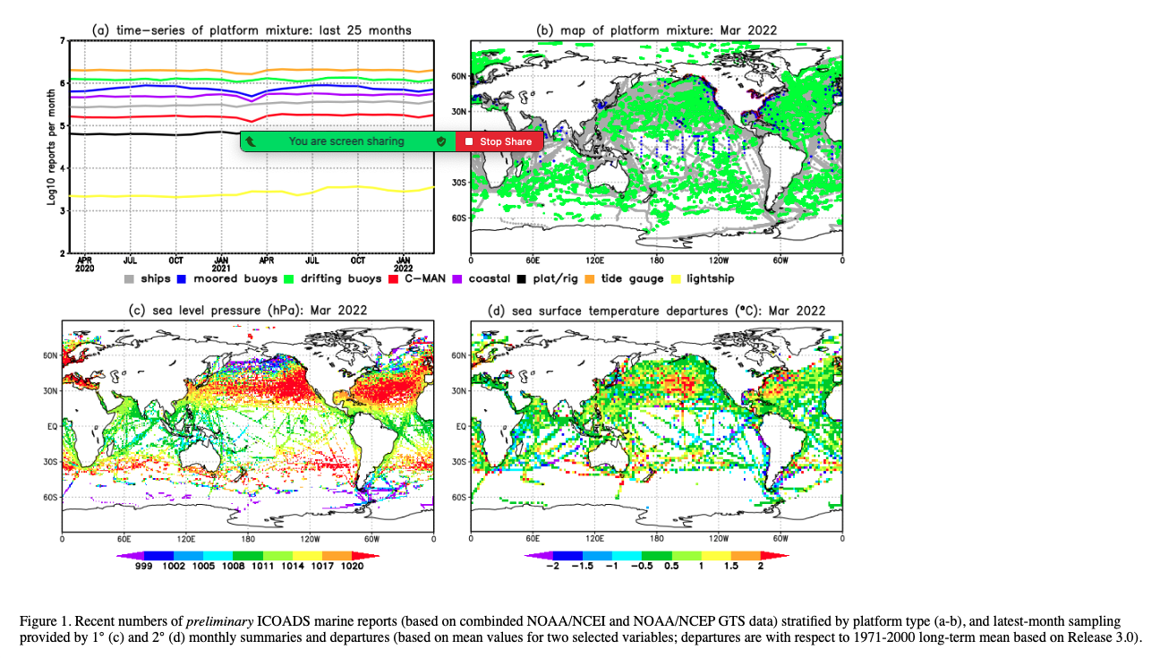
ICOADS ship log data - https://icoads.noaa.gov
Notes:
ICOADS ship log data – used for climate research – ship logs
Full lat-long for every trip.
Drew regions on a map on the sources / destinations. Any ship that left and arrived within 28 days.
1950-2010

Slide 44
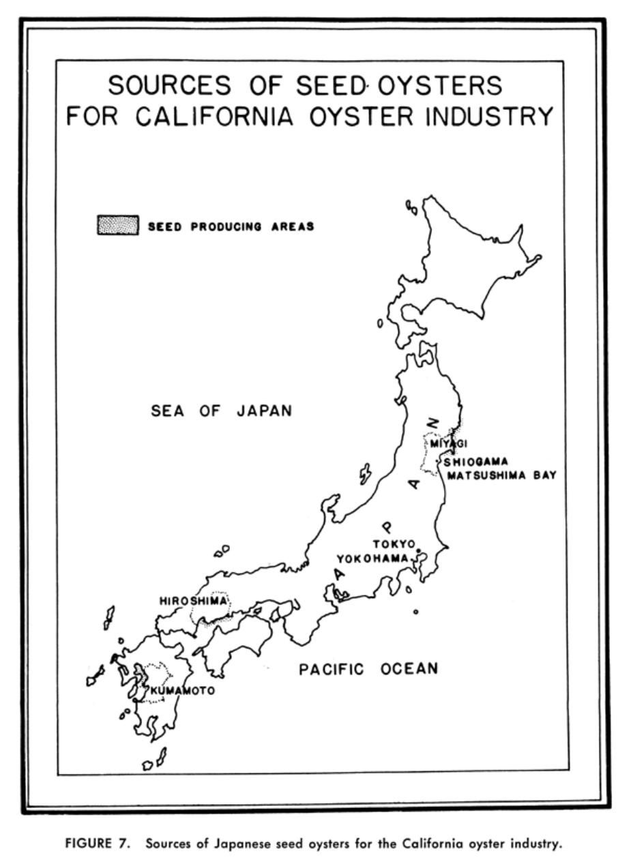
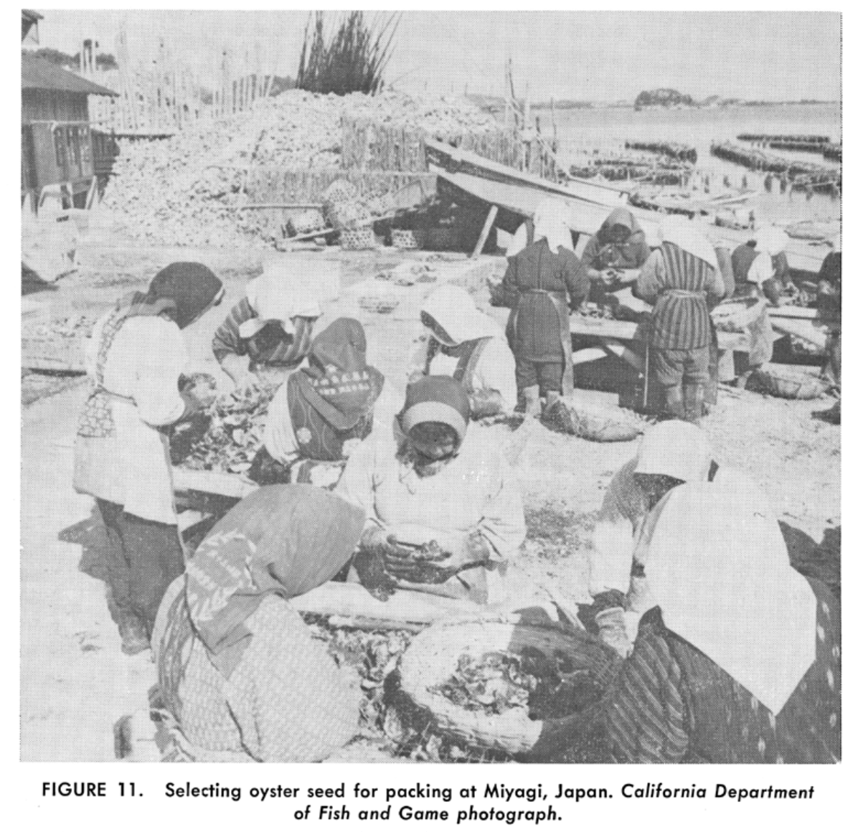
Barrett 1963

Slide 45
Colors for the PC

Slide 46
Northern Japan oysters (38% mortality)
Southern Japan oysters (74% mortality)
Northern (44ºN) Japanese oysters had greater fitness in Puget Sound WA (47ºN) relative to Southern (33ºN) Japanese oysters
Northern Japan
Southern Japan

Slide 47
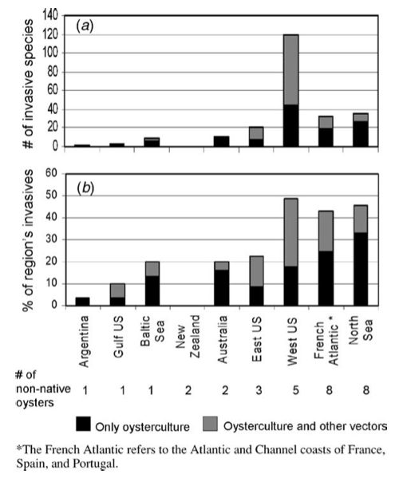
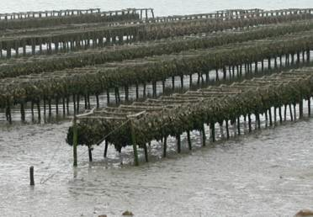
Dozens of species that moved with C. gigas
Ruesink et al. 2005 ARES

Slide 48
Biological invasions are a major driver of ecosystem degradation. The number of invasive alien species is increasing rapidly with no evidence that either the rate of species introduction or the emergence of new invasive species is slowing down. Pyšek et al 2020 Biological Review
One critical piece of the puzzle in the understanding of biological invasions is an understanding of the his- tory of the invasion process, including the geographical pathways followed by the founders of the invading populations. Indeed, the genetic variability of invading populations, in terms of both molecular and quantita- tive traits, depends on the history of their populations of origin and the historical and demographical features of their introduction. Estoup and Guillemaud 2010 ME.

Slide 49
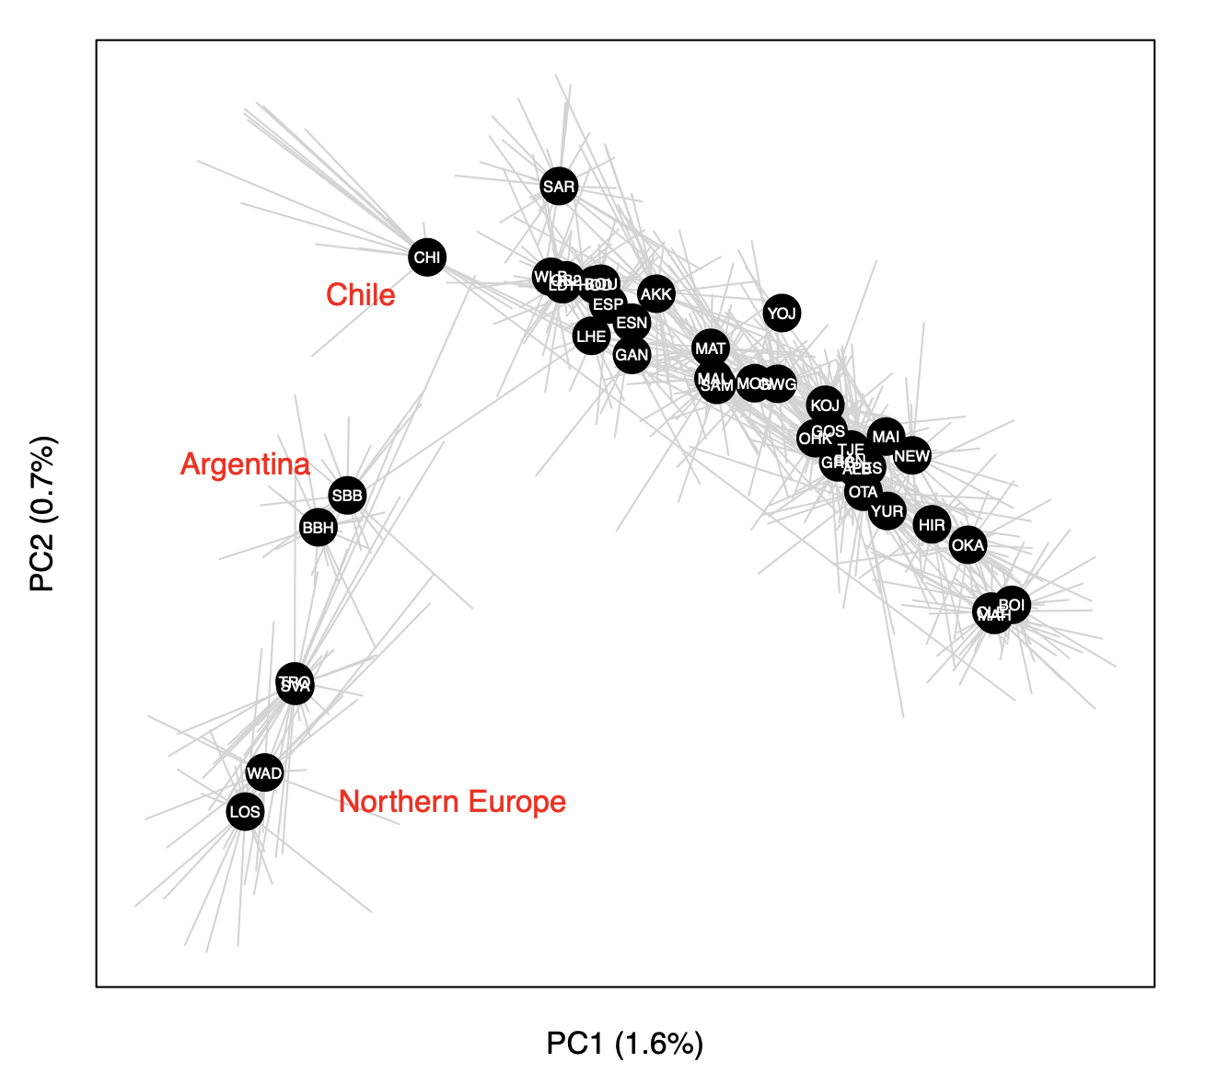
Principal components analysis (PCA) of 726 oysters using 7046 loci

Slide 50
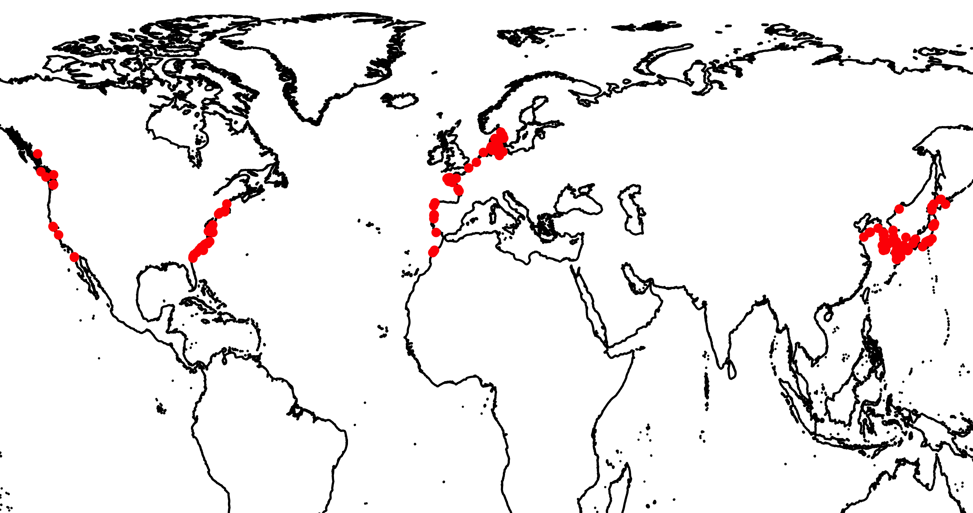
G. vermiculophylla distribution
Introduced: Europe
Introduced: North America
Native

Slide 51
Source of the invasion is northeastern Japan
Annual Sea Surface
Temperature (ºC)
Flanagan, Krueger-Hadfield, Murren, Nice, Strand and Sotka (in press) Molecular Ecology

Slide 52
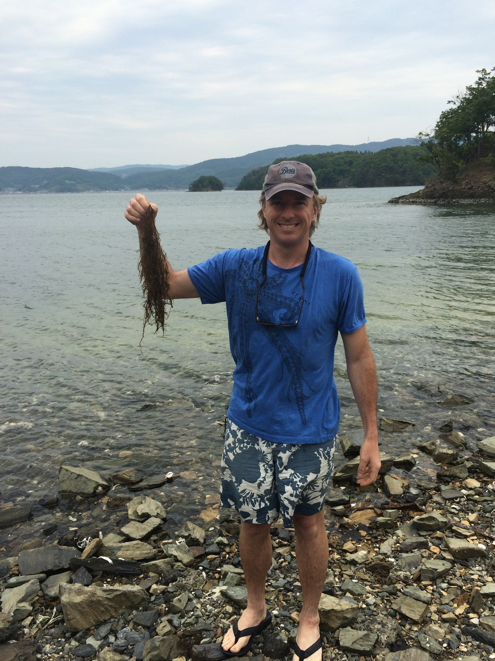
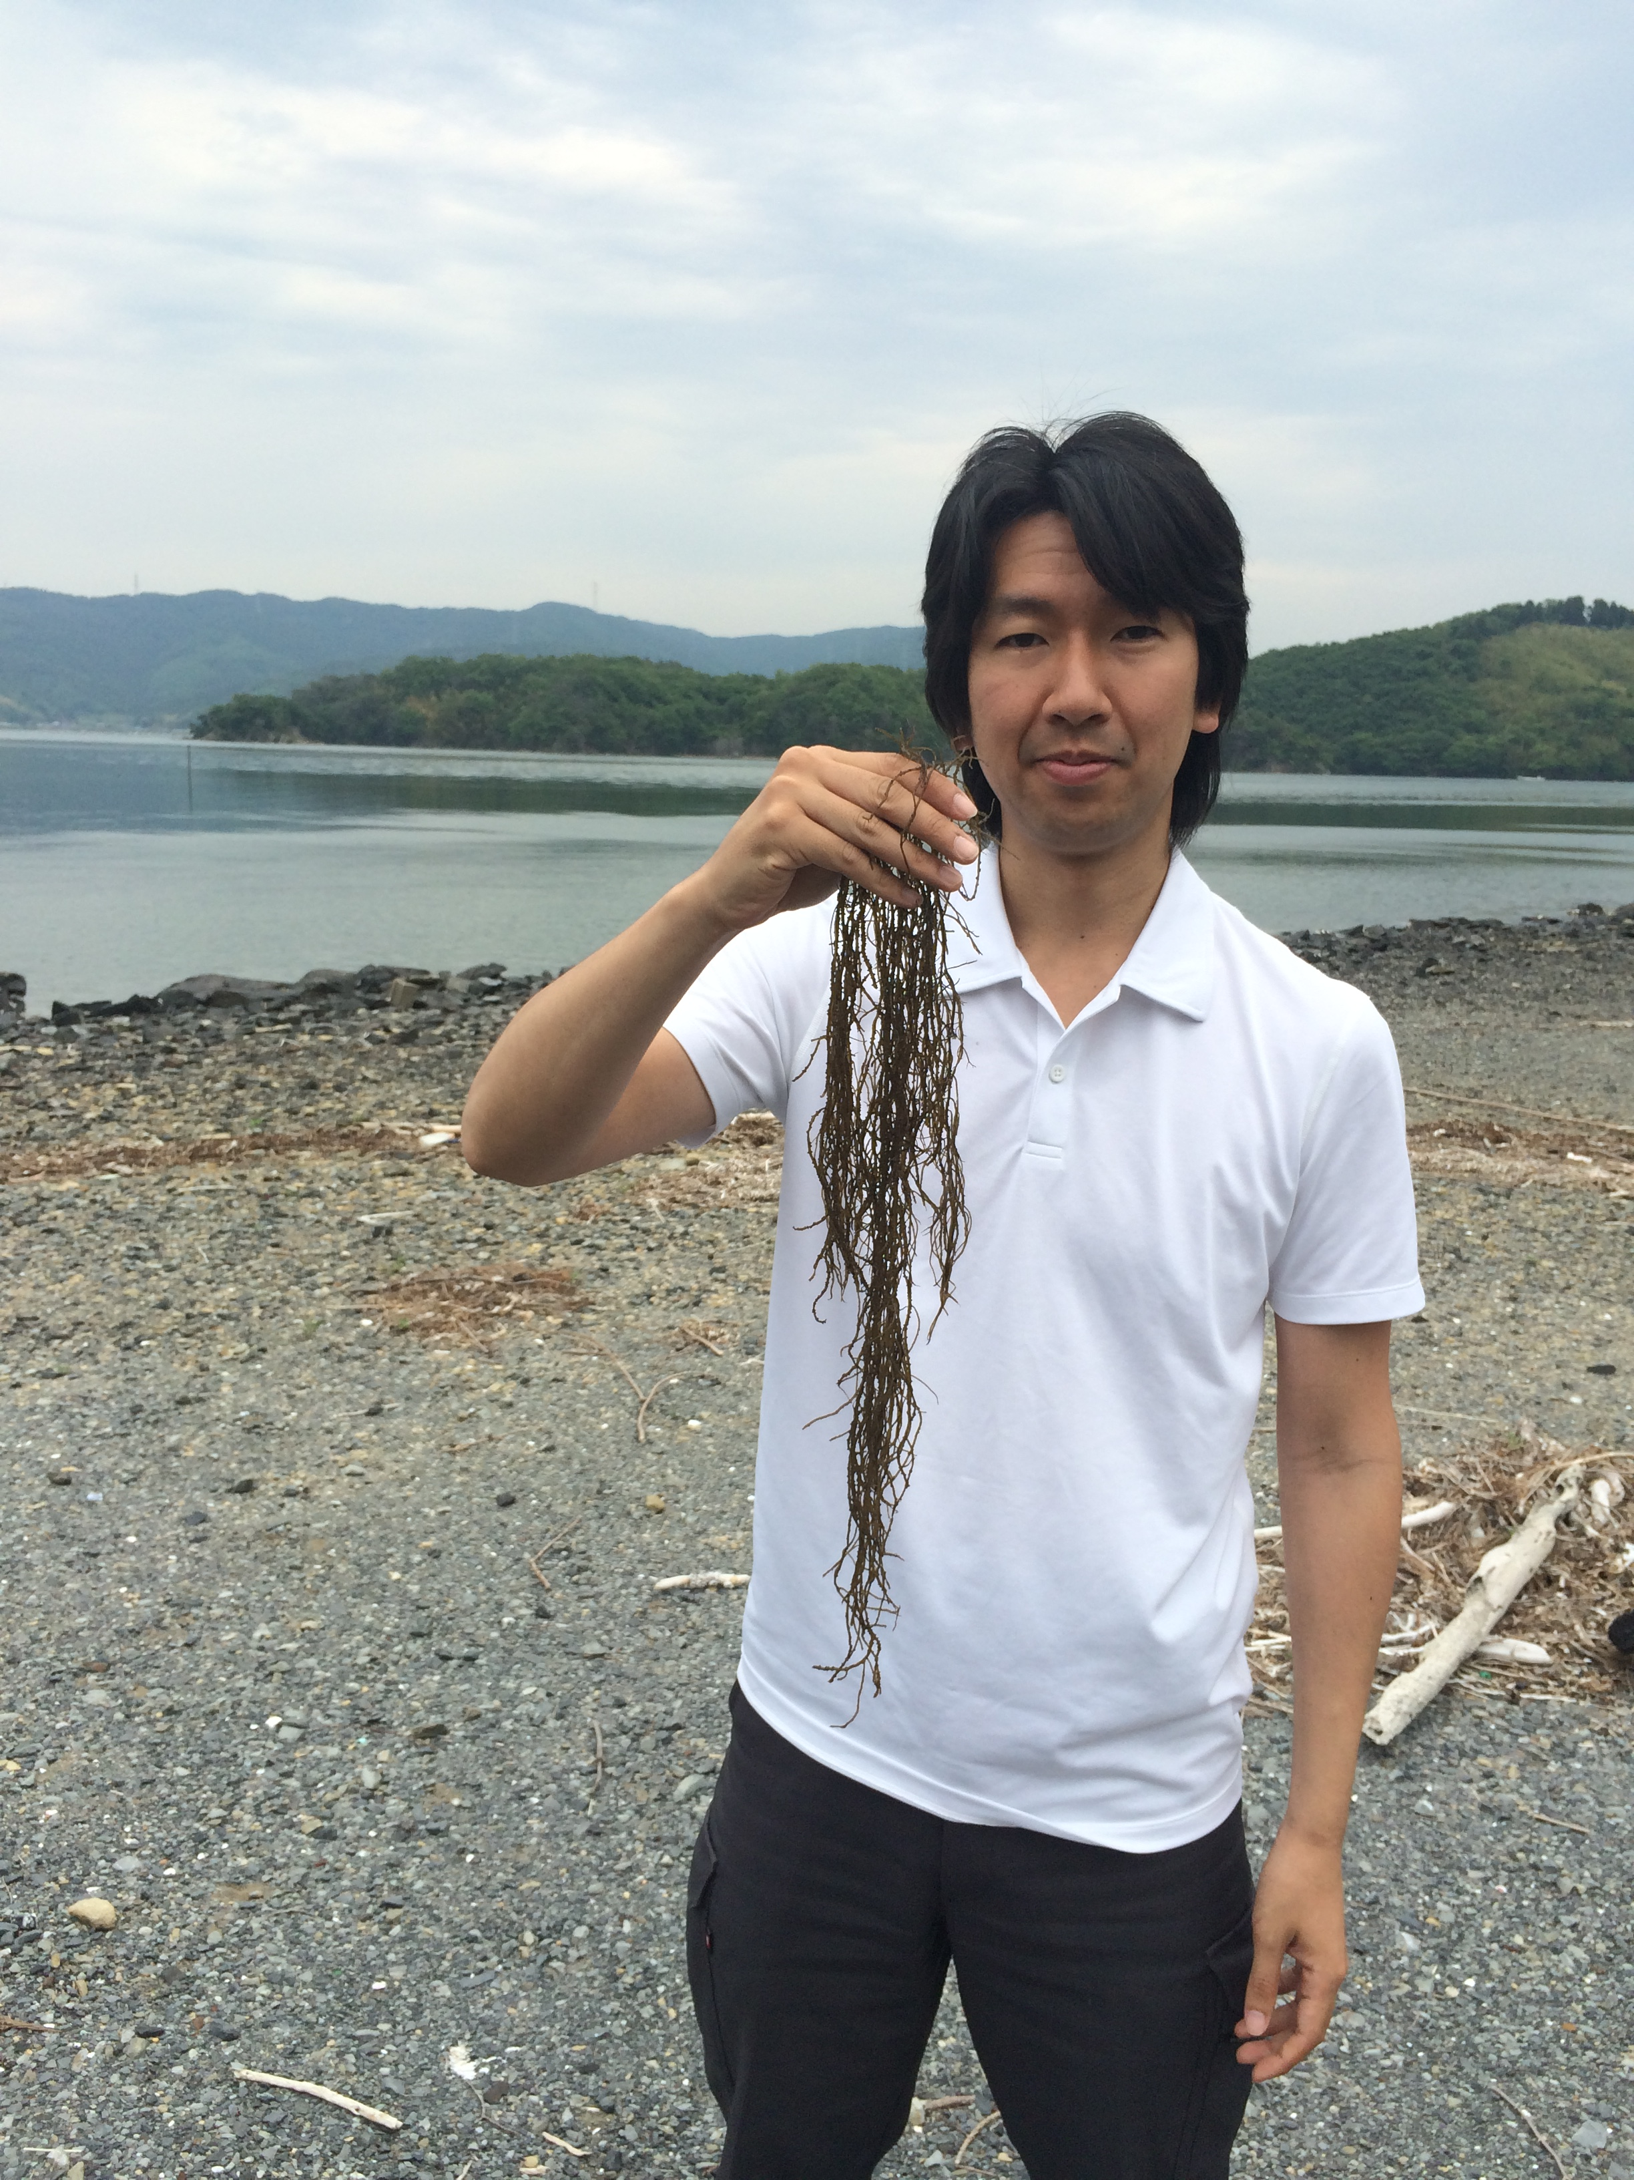
Mangoku-ura, Japan
May 2015

